Slide 1
Scrum-Agile Approach Overview
Dre’ Scheetz
IDS 100
08/07/2021
Notes:
Scrum-Agile Approach Overview
Dre’ Scheetz
IDS 100
08/07/2021

Slide 2
Roles of an agile team & their importance.
Developer — Without them, there would be no product to deliver.
Product Owner — Maintains the product vision during the SDLC, allowing other team members to focus on their roles without concern for the product’s success.
Scrum Master — Ensures Scrum and its values are implemented correctly, teams and stakeholders communicate effectively, and team cohesion.
Tester — Provides concise Definitions of Done and continuously assists in product quality.
Notes:
Roles of an agile team & their importance.
Developer — Without them, there would be no product to deliver.
Product Owner — Maintains the product vision during the SDLC, allowing other team members to focus on their roles without concern for the product’s success.
Scrum Master — Ensures Scrum and its values are implemented correctly, teams and stakeholders communicate effectively, and team cohesion.
Tester — Provides concise Definitions of Done and continuously assists in product quality.

Slide 3
Developer
Accountable for:
Creating a plan for the Sprint and Sprint Backlog
Adapting to changes in the Product Backlog
Fellow developers in professionalism and respective work
Collective ownership of code.
Self Organizes into a cohesive team to implement user stories and meet acceptance criteria and Definitions of Done each Sprint.
Will typically utilize cross-functionality, pair programming, continuous integration & code refactoring.
Schwaber, K. & Sutherland, J, 2020
Notes:
Developer
Self Organizes into a cohesive team to implement user stories and meet acceptance criteria and Definitions of Done each Sprint.
Will typically utilize cross-functionality, pair programming, continuous integration & code refactoring.
Accountable for:
Creating a plan for the Sprint and Sprint Backlog, Adapting to changes in the Product Backlog, Fellow developers in professionalism and respective work, Collective ownership of code.
Schwaber, K. & Sutherland, J, 2020

Slide 4
Product Owner
Accountable for:
The Product’s success
Communicating Product Vision
Product Backlog Management
Reordering of the backlog on requirement changes
Delegation if necessary
Works with stakeholders to define requirements. Communicates effectively with the team to ensure product goals are met.
“The Product Owner is one person, not a committee.”
Represents the users and stakeholders of the product.
Schwaber, K. & Sutherland, J, 2020
Notes:
Product Owner
Works with stakeholders to define requirements. Communicates effectively with the team to ensure product goals are met.
“The Product Owner is one person, not a committee.” Represents the users and stakeholders of the product.
Accountable for:
The Product’s success, Communicating Product Vision, Product Backlog Management, Reordering of the backlog on requirement changes. Delegation if necessary
Schwaber, K. & Sutherland, J, 2020

Slide 5
Scrum Master
Accountable for:
Establishing Scrum
Development Team’s effectiveness
Coaching and training in Scrum
“Removal of impediments to the Scrum Team”
Scrum events
Enacting Empiricism
The Scrum Master serves the team and organization to assist in the product’s progress by:
Helps the team stay focused, training in cross-functionality and self-organization, organizational communication, and keeping events productive and positive.
Schwaber, K. & Sutherland, J, 2020
Notes:
Scrum Master
The Scrum Master serves the team and organization to assist in the product’s progress by:
Helps the team stay focused, training in cross-functionality and self-organization, organizational communication, and keeping events productive and positive.
Accountable for:
Establishing Scrum, Development Team’s effectiveness, Coaching and training in Scrum, “Removal of impediments to the Scrum Team,” Scrum events, Enacting Empiricism
Schwaber, K. & Sutherland, J, 2020

Slide 6
Tester
Accountable for:
Acceptance tests
Automated regression testing
Concurrent testing
Testing Environment
Test Levels
Determining and reporting what is functional in the product
Works closely with Developers and the Product Owner to provide acceptance criteria, Definition of Done, and product-related testing.
Other duties of testers: proactive participation, user story risk analysis, breaking down user stories, and coaching on testing.
CGhahrai, 2017
Notes:
Tester
Works closely with Developers and the Product Owner to provide acceptance criteria, Definition of Done, and product-related testing.
Other duties of testers: proactive participation, user story risk analysis, breaking down user stories, and coaching on testing.
Accountable for:
Acceptance tests, Automated regression testing, Concurrent testing, Testing Environment, Test Levels, ++Determining and reporting what is functional in the product
CGhahrai, 2017

Slide 7
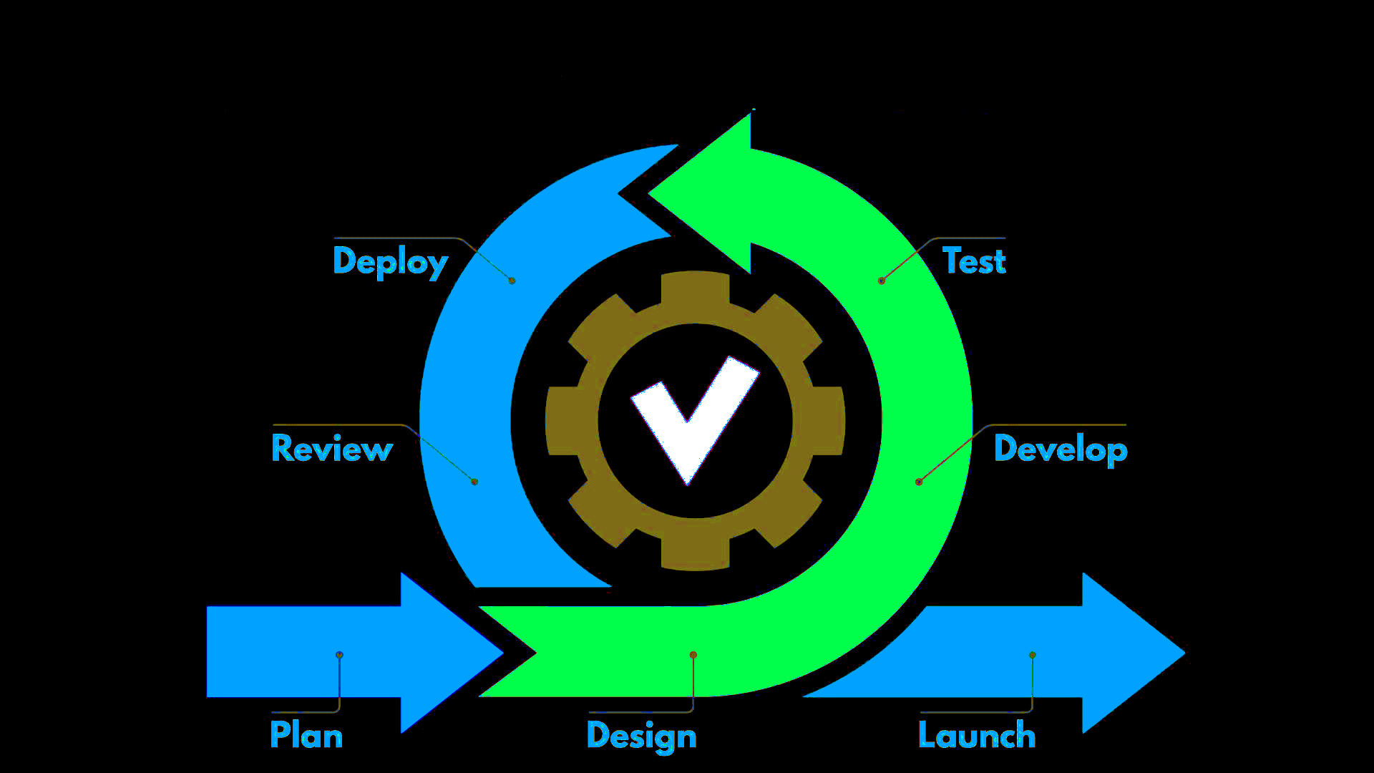
SDLC with Agile
Notes:
SDLC with Agile
Plan->Design->Develop->Test->Deploy->Review->Launch

Slide 8

Plan
Stakeholders will meet with the Product Owner, then; Product Owner will complete the Product Backlog.
Prior to every Sprint, each User Story will be evaluated for inclusion.
Story points and estimations will be established.
Although the Product Backlog will be ordered prior, finalization for the Sprint will take place.
“Task level planning of the meeting without the product owner.”
Cobb, C. G., 2015
Notes:
Plan
Stakeholders will meet with the Product Owner, then; Product Owner will complete the Product Backlog.
Prior to every Sprint, each User Story will be evaluated for inclusion.
Story points and estimations will be established.
Although the Product Backlog will be ordered prior, finalization for the Sprint will take place.
“Task level planning of the meeting without the product owner.”

Slide 9

Design
With the User stories decided on, the Sprint backlog and Sprint Goals will be defined.
Requirement specifications are studied and defined.
Code will be drafted or planned out to implement.
Tutorialspoint, n.d.
Notes:
Design
With the User stories decided on, the Sprint backlog and Sprint Goals will be defined.
Requirement specifications are studied and defined.
Code will be drafted or planned out to implement.
Tutorialspoint, n.d.

Slide 10

Develop
The bulk of the sprint.
Step to implement user stories into a viable product.
Rapid development to meet Definitions of Done.
Functionality is prioritized through pair programming.
Code Refactoring takes place to ensure maintainability and reduce redundancy.
Continuous Integration is done to implement new features while considering risk.
Cobb, C. G., 2015
Notes:
Develop
The bulk of the sprint.
Step to implement user stories into a viable product.
Rapid development to meet Definitions of Done.
Functionality is prioritized through pair programming.
Code Refactoring takes place to ensure maintainability and reduce redundancy.
Continuous Integration is done to implement new features while considering risk.
Cobb, C. G., 2015

Slide 11

Test
While testing is considered a step, it should be done proactively during development.
Validates that code and features done during development meet User Story functionality, known as acceptance tests.
Repeatable tests implemented to ensure features implemented still function.
Testing for everything is not possible, so tests may be phased out in favor of efficiency.
Cobb, C. G., 2015
Notes:
Test
While testing is considered a step, it should be done proactively during development.
Validates that code and features done during development meet User Story functionality, known as acceptance tests.
Repeatable tests implemented to ensure features implemented still function.
Testing for everything is not possible, so tests may be phased out in favor of efficiency.
Cobb, C. G., 2015

Slide 12

Deploy
Continuous Integration is done to implement new features while considering risk. (Cobb, C. G., 2015).
The code developed during the sprint is integrated into the product for iterative product release.
Code deemed non-functional would not be integrated. (Tutorialspoint, n.d.).
Conflicts may arise at this step needing to be addressed or noted for the next sprint.
Notes:
Deploy
Continuous Integration is done to implement new features while considering risk. (Cobb, C. G., 2015).
The code developed during the sprint is integrated into the product for iterative product release.
Code deemed non-functional would not be integrated. (Tutorialspoint, n.d.).
Conflicts may arise at this step needing to be addressed or noted for the next sprint.

Slide 13

Sprint Retrospective (Review)
Team reflection on the last iterative sprint.
Topics of discussion will include areas of improvement, lessons learned, and user stories not fully addressed.
Allows for the next iteration to be adaptive.
Opportunity for better team cohesion.
Just as important as every other process.
Cobb, C. G., 2015.
Notes:
Sprint Retrospective (Review)
Team reflection on the last iterative sprint.
Topics of discussion will include areas of improvement, lessons learned, and user stories not fully addressed.
Allows for the next iteration to be adaptive.
Opportunity for better team cohesion.
Just as important as every other process.
Cobb, C. G., 2015.

Slide 14

Agile Use Case: Changing Requirements
Had a waterfall model been used in the development of SNHU Travel, the wellness and detox changes could have damaged the product’s success. Agile is an ideal methodology for implementing changes without disrupting time, scope, and budget as product requests change. Due to planning being a recurrent event instead of being done initially at the start of the SDLC.
Notes:
Agile Use Case: Changi
Had a waterfall model been used in the development of SNHU Travel, the wellness and detox changes could have damaged the product’s success. Agile is an ideal methodology for implementing changes without disrupting time, scope, and budget as product requests change. Due to planning being a recurrent event instead of being done initially at the start of the SDLC.

Slide 15
Considerations
Requirements are clearly understood upfront
Project development cycle will be short
Stages are clearly defined
Waterfall
Teamwork encouraged
Requirement independent
Product partially functional during SDLC
Planning is flexible
Agile
Tutorials Point, n.d
Notes:
Considerations
Waterfall
Requirements are clearly understood upfront
Project development cycle will be short
Stages are clearly defined
Agile
Teamwork encouraged
Requirement independent
Product partially functional during SDLC
Planning is flexible

Slide 16
References
Cobb, C. G. (2015). The Project Manager’s Guide to Mastering Agile: Principles and Practices for an
Adaptive Approach (1st ed.). Wiley.
Ghahrai, A. (2017, January 6). Agile Testing Mindset and the Role of the Agile Tester. DevQA. https://devqa.io/agile-testing-mindset-tester-role-agile-team/
Schwaber, K. & Sutherland, J. (2020, November). The Scrum Guide: the definitive rules of the game. Scrum.org and ScrumInc.
Tutorials Point. (n.d.). SDLC - Waterfall Model. Retrieved September 2, 2021, from https://www.tutorialspoint.com/sdlc/sdlc_waterfall_model.htm
Notes:
References
Cobb, C. G. (2015). The Project Manager’s Guide to Mastering Agile: Principles and Practices for an
Adaptive Approach (1st ed.). Wiley.
Ghahrai, A. (2017, January 6). Agile Testing Mindset and the Role of the Agile Tester. DevQA.
https://devqa.io/agile-testing-mindset-tester-role-agile-team/
Schwaber, K. & Sutherland, J. (2020, November). The Scrum Guide: the definitive rules of the game.
Scrum.org and ScrumInc.
Tutorials Point. (n.d.). SDLC - Waterfall Model. Retrieved September 2, 2021,
from https://www.tutorialspoint.com/sdlc/sdlc_waterfall_model.htm

